Slide 1
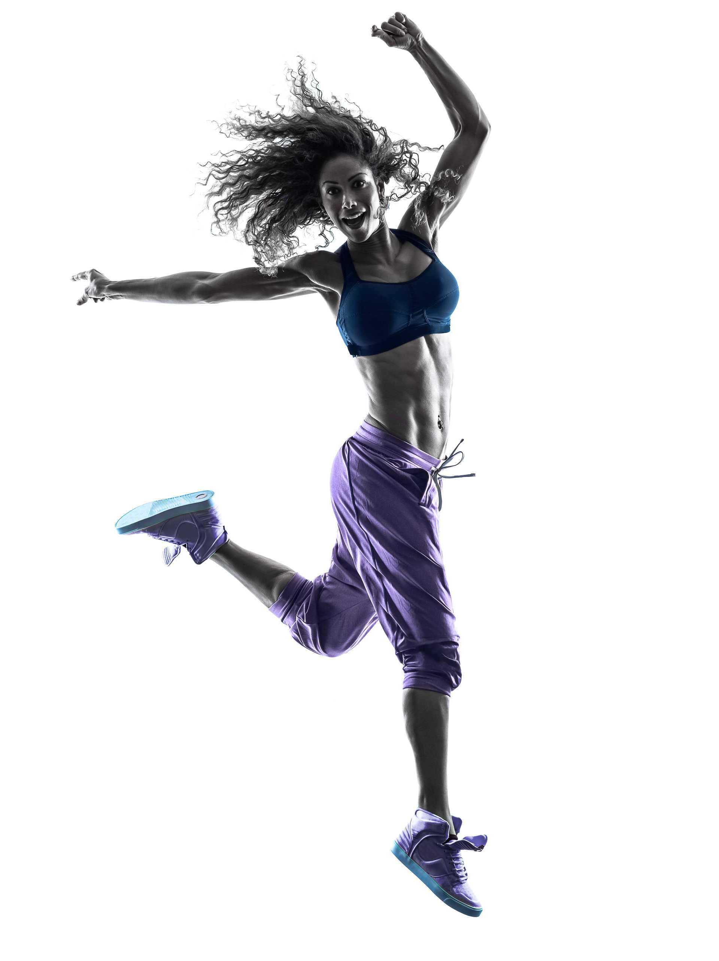

active
advertising

Slide 2
Active Advertising
Marketing and media specialists are
always looking for ways to generate active engagements between highly sought after consumers and the brands they represent.
It gives you instant access to millions of highly motivated and ambitious people with money to spend and a proven preference for high-end goods and luxury brands.
Boomerang Media has created a fast track solution that gets you up close and personal with the audience you are trying to reach at
a time when they are receptive to advertising.
This innovative yet established marketing channel is exclusive to Boomerang Media.
We call it Active Advertising.

Slide 3
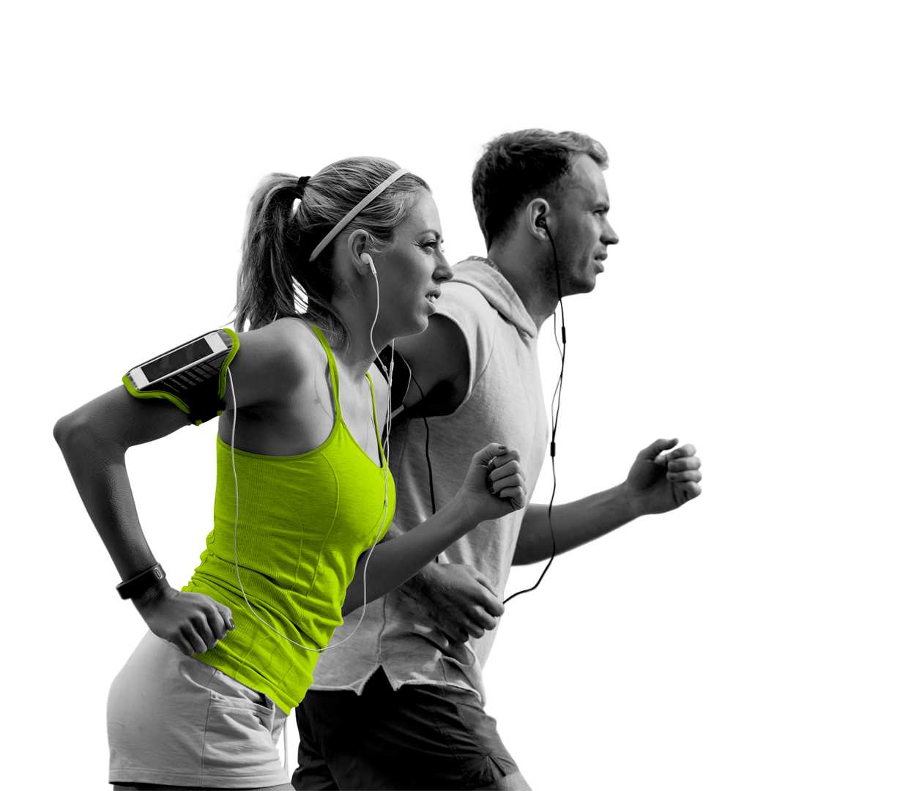

Find us in health and fitness clubs
and read on to discover more about our values, beliefs and motivations.

Slide 4
Me time
It is always hard to hit a moving target and is equally difficult to hold the attention
of people who are channel hopping, page turning or surfing the web.
And the place that successful, affluent and aspirational people go to spend time on themselves is a health club.
Now, with Active Advertising, you can promote your products, services and events to members of some of the market leading health and fitness clubs in the UK, including David Lloyd, Nuffield Health and Pure Gym.
The best time to approach prospects with something they may want is when they are feeling positive and focused on their own needs and desires. Enjoying a bit of ‘me time’.

Slide 5
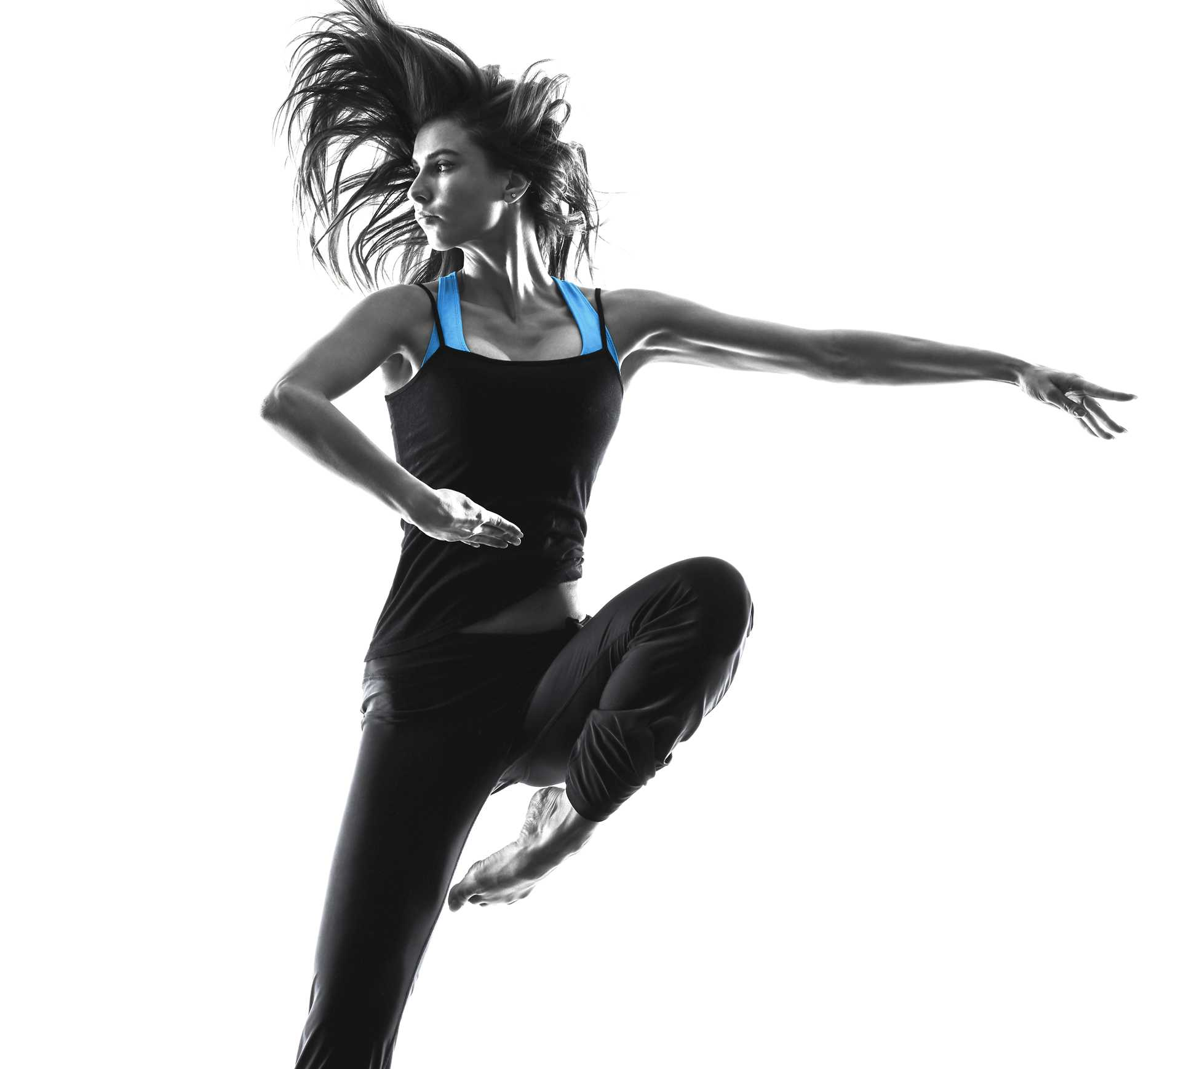
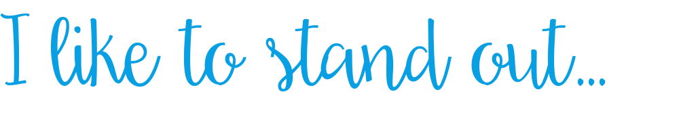
I like to look great, I spend my time and money shopping for high-end beauty products and jewellery.
I go to the gym 3 times a week.
45% of members say that they tend to go for premium rather than standard products. Active Advertising can get you close to these people.

Slide 6
Aspirational consumers
Gym members go to the gym to get fit and look good. It is therefore safe to say they care about their bodies, their appearance and their image, so they will be interested in hearing about health & fitness products.
According to authoritative research (see overleaf), those that place the most importance on gym attendance are the types of people who want to try everything now and are happy to spend money to do so.
But they are receptive to so much more.
Therefore, if you have a product, service or event to promote – from beauty products to clothes to holidays – you will find your target audience in a health club.

Slide 7


I love the great things in life.
I’m always trying new things and love sharing my experiences with friends on social media. I go to the gym 3 times a week.
80% of members will have their smartphones with them in the gym and spend on average 685 minutes per month on Facebook. Active Advertising will connect you with them while they are connecting with their network.

Slide 8
Active values
Chris Rose published a ground-breaking
book ‘What Makes People Tick’ which uses
a values mode system of people profiling (developed by the Cultural Dynamics Strategy and Marketing Consultancy) to reveal the unconscious drivers and motivations behind
all human behaviour.
It explores how these values are liked directly to emotions and underpin people’s attitude to almost everything they do.
For those involved in marketing, this book is the equivalent of an industry bibe.
See more information on values-based profiling at:
www.cultdyn.co.uk/valuesmodes.html

Slide 9

I am always out with my friends and love catching up over dinner or a few drinks.
I like to watch the latest film releases and I go to the gym 3 times a week.
66% of gym goers say they love eating out & drinking with friends. Let Active Advertising help you reach these people.

Slide 10
Beliefs & motivations
According to the Cultural Dynamics system, people can be divided into 12 distinct types by their shared values, beliefs and motivations. Those who believe that “visiting a gym should be an important part of a person’s lifestyle” are classified as either Golden Dreamers or Now People, depending on their other shared values.
Golden Dreamers like to try anything and acquire symbols of success.
Now People want everything now and ‘just do it’, whatever the financial cost.
If you are a marketing or media specialist with
a premium brand to promote these are exactly the kinds of people you want to be talking to.

Slide 11
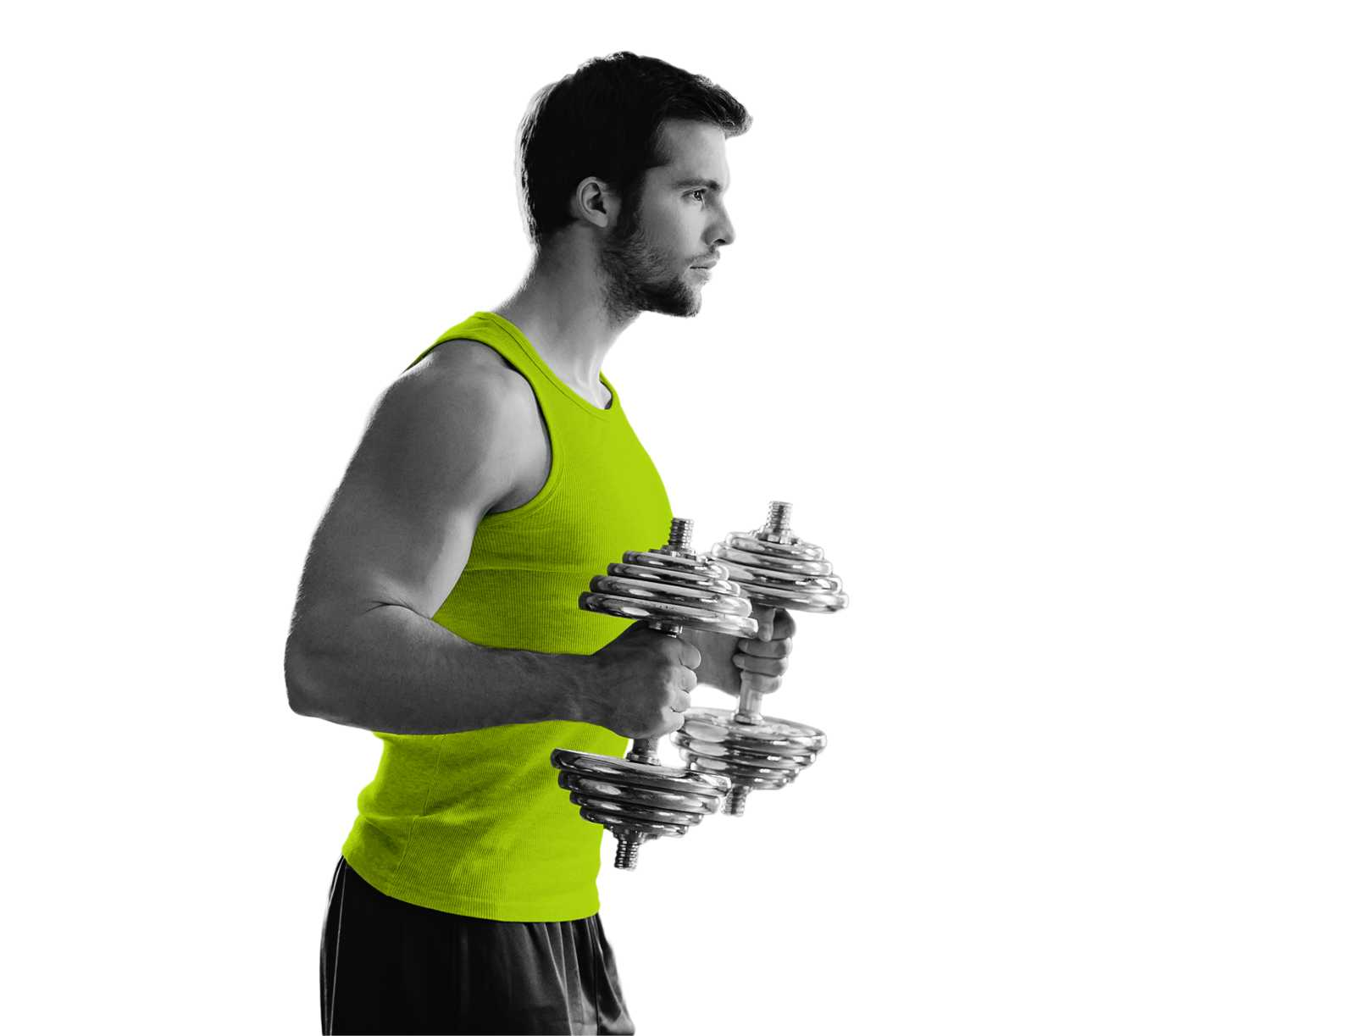

I love spending money on premium products. I never leave the house without my designer brand clothes and aftershave. I go to the gym 3 times a week.
80% of members say they can’t resist purchasing expensive perfumes or aftershave and 45% tend to go for premium goods. Active Advertising will connect you to them.

Slide 12
Active results
But active advertising is not just a values matching proposition.
The results point to a sub-set of consumers
who are positive, motivated, ambitious and aspirational whilst at the gym – which makes them highly receptive to advertisements for premium products and experiences.
Boomerang Media commissioned an independent study (by Dipsticks Research)
to investigate the mind-set of health club members and the media effectiveness rates
in this closed group.
Request a research report to find more on research findings at:
www.boomerangmediagroup.co.uk/contact-us

Slide 13

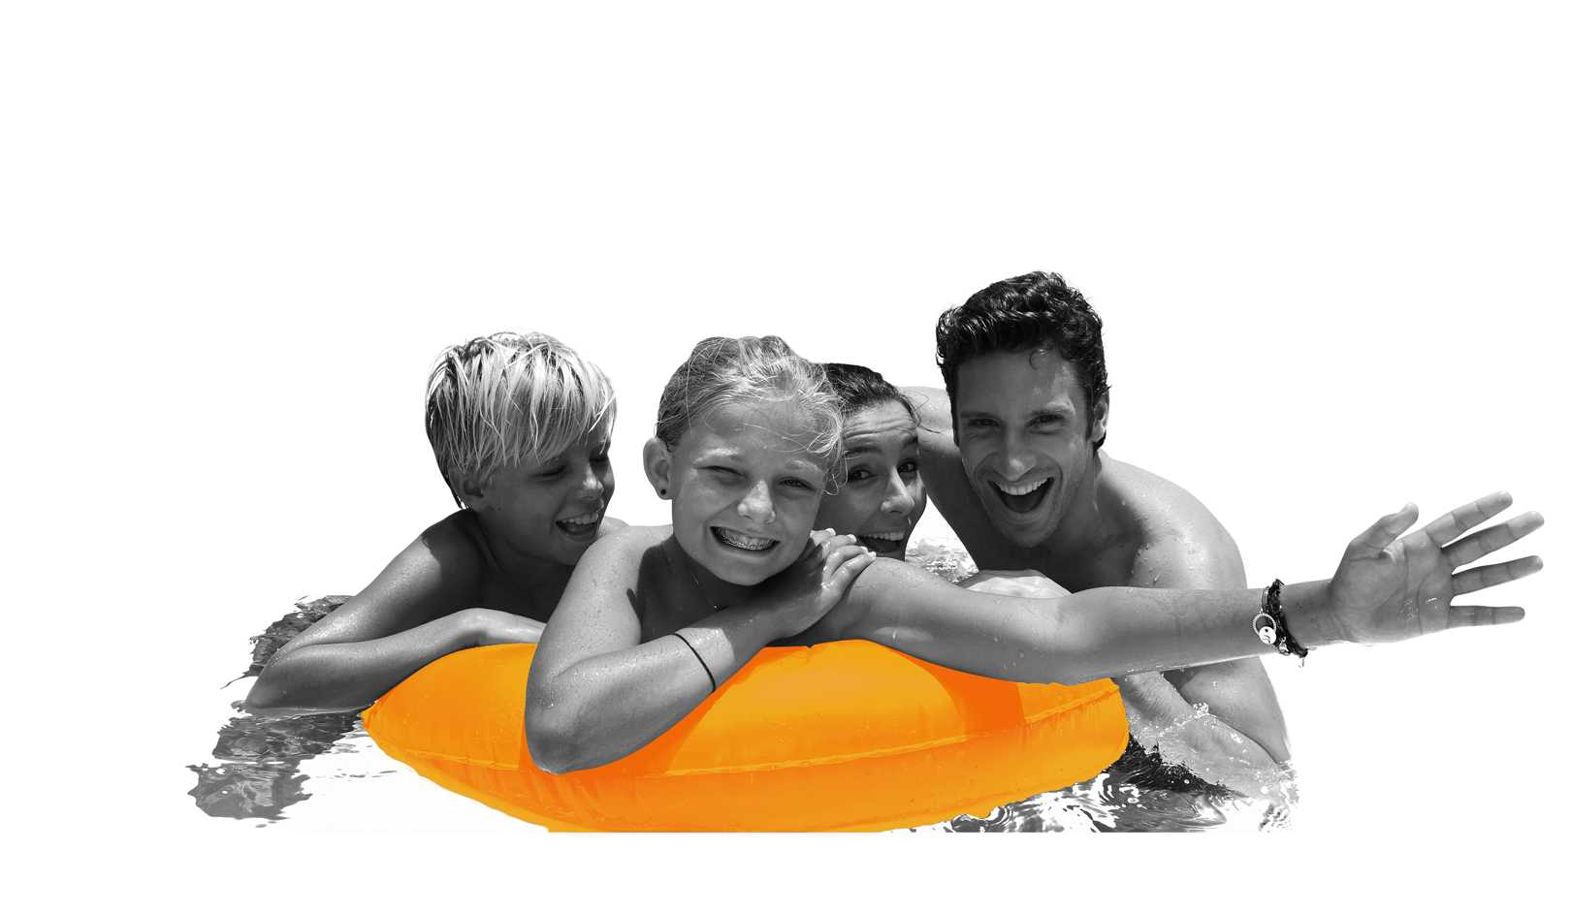
I buy my family only the best quality, nutritious food. I love shopping and socialising with friends and family. I go to the gym with my family 3 times a week.
79% of members say it’s worth paying more for quality good. Active Advertising helps you reach them.

Slide 14
Receptive mindset
Motivated
Members visit their clubs on average 3.5 times a week
94% have a positive mind-set at the gym
Aspirational
79% say that it is worth paying extra for quality good
75% regularly treat themselves
Ambitious
60% want to get to the top of their career
Members are 26% more likely to earn at least £50.000
Receptive
43% often notice adverts around the gym
33% are more likely to buy products they see advertised around the gym

Slide 15
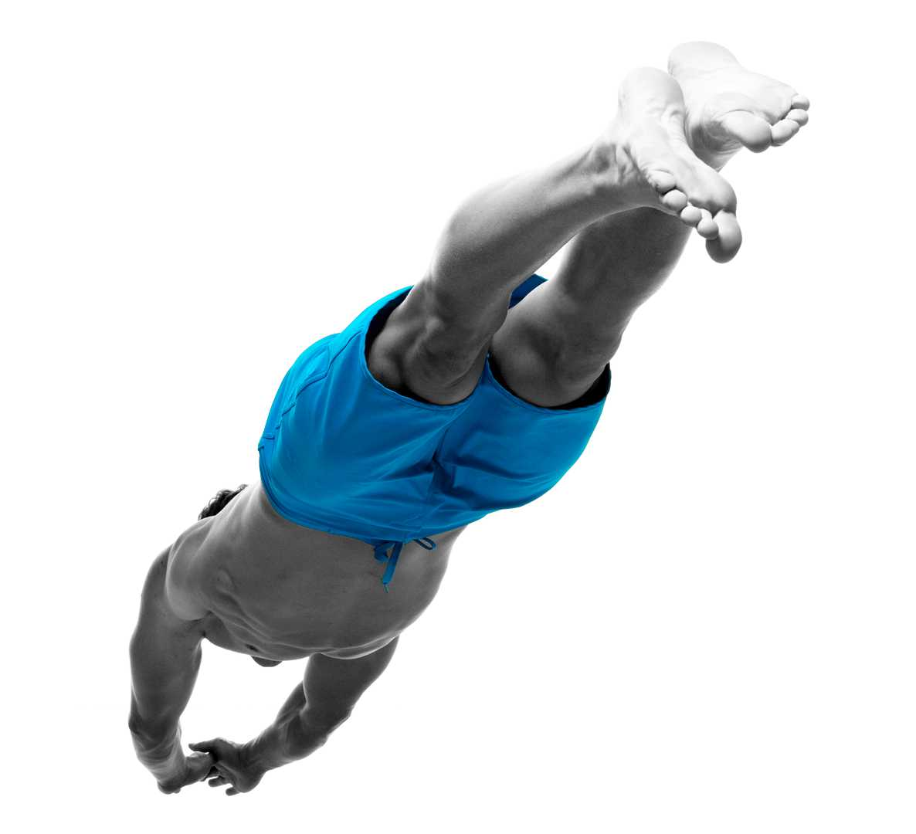

I live life to the full by taking part in extreme sports and going on holiday to exotic places. I keep in shape by going to the gym 3 times a week.
Gym goers are 3.5 times more likely to book up to 3 holidays a year. Active Advertising can connect you directly to people like this.

Slide 16
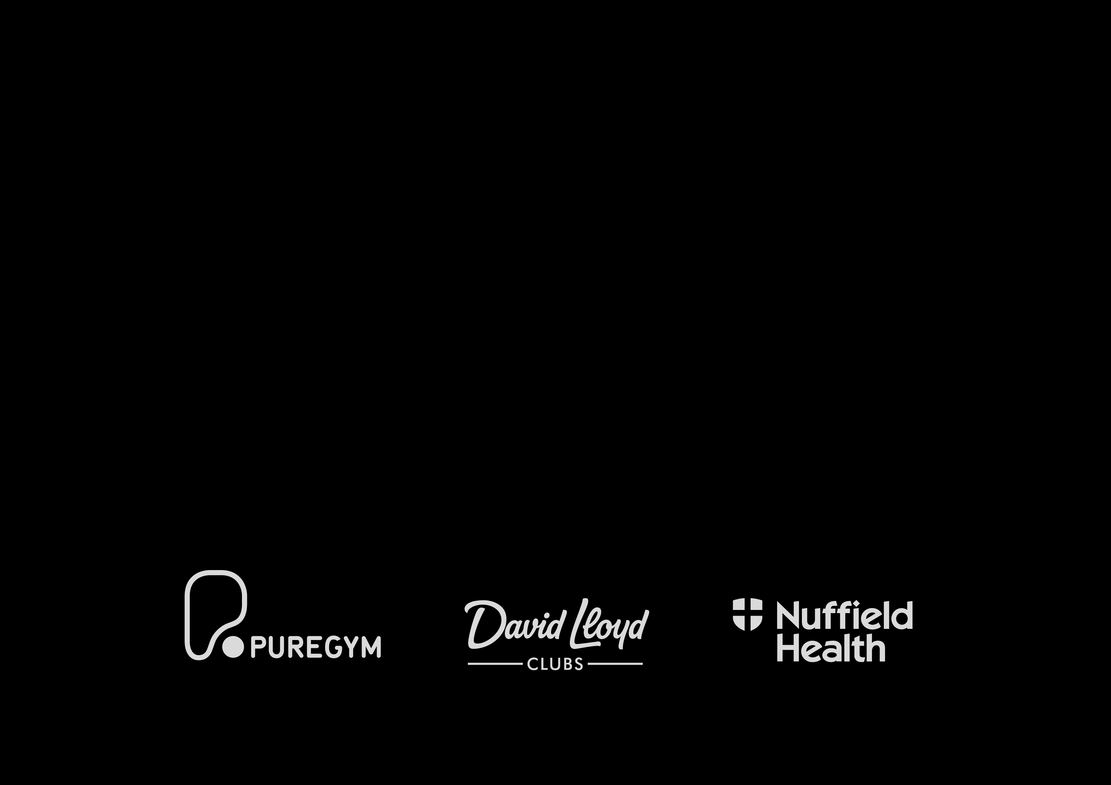
Active opportunity
Boomerang Media can get you close to this highly sought after audience through our market-leading health clubs. We offer a range of media formats including high impact posters, sampling, ambient and our latest edition to the portfolio – HD digital screens.
You can reach a highly targeted audience through our health clubs, which all have a
75%+ ABC1 member demographic. David Lloyd and Nuffield Health offer premium families
and AB individuals, whilst value chains like Pure Gym get you close to young professionals.

Slide 17
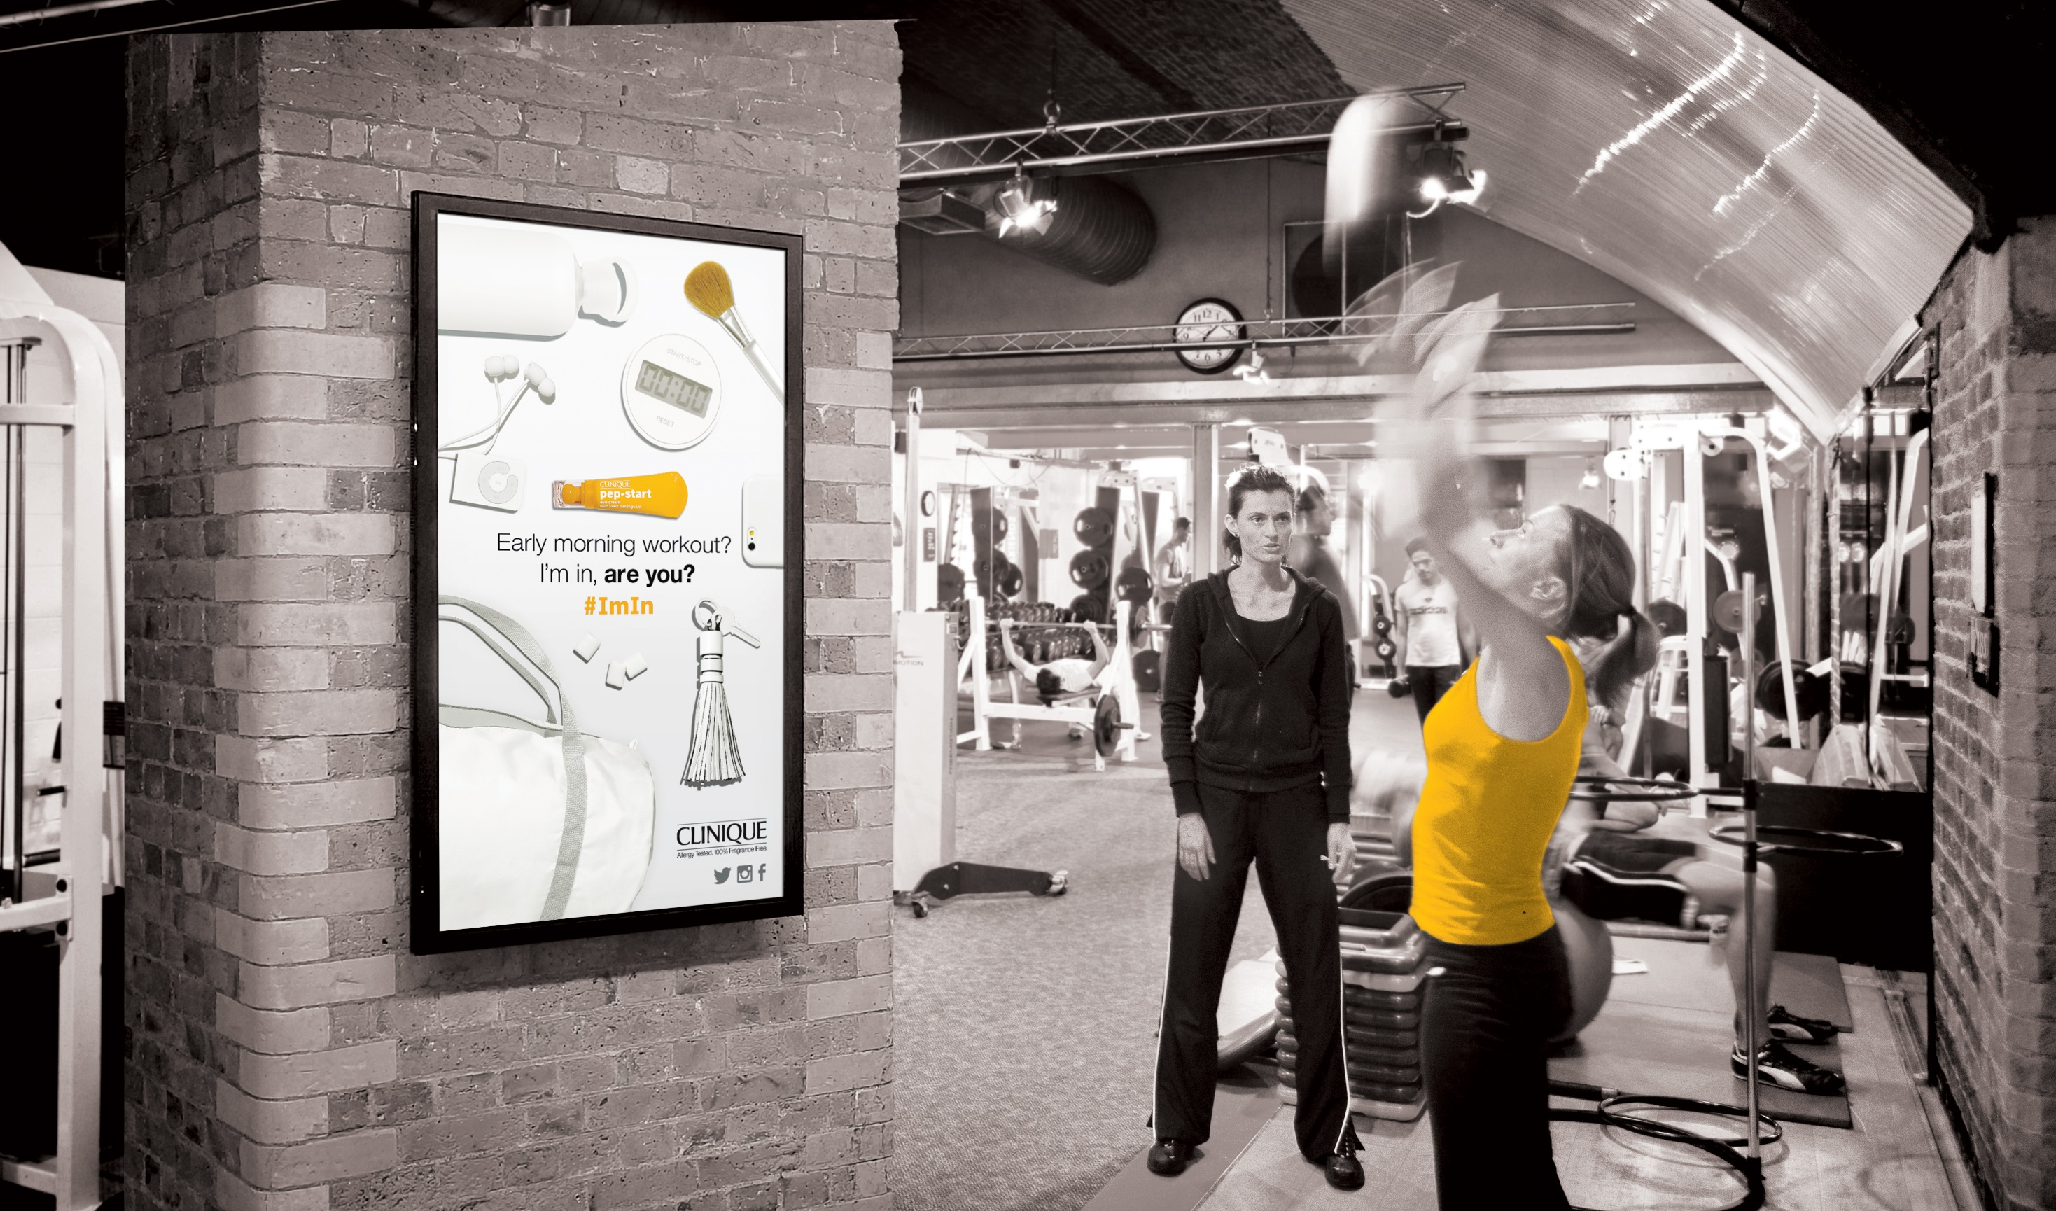

Slide 18
Get in touch
If you want to reach this desirable audience, at a time when they are most receptive, reach for the phone and request a full presentation, or visit our website to find out more about the benefits of Active Advertising.
01252 368 368
info@boomerangmedia.co.uk
boomerangmedia.co.uk

Slide 19
